Slide 1

How to measure quality of LLMs
Lessons learned from creating a benchmark dataset for Cyber Threat Intelligence – plus insights from work in progress
Aaron Kaplan (aaron@lo-res.org, AT); Jay Jacobs (Cyentia, US); Paolo Di Prodi (PRIAM.ai, IT); Syra Marshall (ELEMENDAR, GB)

Slide 2
Intro speakers & team
Intro AI SIG
What is the benchmark dataset sub-group?
Speakers here: Aaron Kaplan, Paolo di Prodi, Syra Marshall
Wider team: Ben Strickson (Elemendar), David Bianco, Jay Jacobs, Marco Caselli, Patrick Grau, Shin Adachi

Slide 3
Disclaimer
Aaron
All things said and presented here do not represent the European Commission or the Commission’s position nor does it suggest any endorsement
All errors are mine to keep
I present this here as a sole proprietor company under my own name
Jay, Syra, Paolo
They represent their respective companies

Slide 4
Disclaimer Continued!
This is all still very much WIP
We present here to:
Find people who work on similar things
Help people to avoid the same mistakes we did ☺
Learn from each other & collectively improve the work on CTI AI models
So, do not assume this presentation represents something authoritative. We are all discovering….
… because there seems to be no comprehensive, good CTI benchmark dataset for LLMs

Slide 5
Why to use LLMs for CTI?
The goal of CTI is to know where to look (and how to pivot, how to connect the dots and anticipate the adversaries moves)
This implies a couple of use-cases:
UC 1: CTI analysists need to be up to date all the time → Summarization
UC 2: Analysts might want to search (question-answering) on CTI reports (+ translation: I-S00N leak) → RAG
UC 3: Analysts would like to get the information out (“information extraction”) from CTI reports → NER
UC 4: Mapping TTPs / text to MITRE Att&ck T-Codes
UC 5: Extract relationships (“Threat Actor xyz is using Tool ABC to achieve 123”) → put into knowledge graph / STIX 2.x

Slide 6
Constraints in the CTI work-environment
Very often, we can not use ChatGPT/openai/anthropic/etc. via API
Data needs to stay internal
Local models FTW!
But: are they just as good?
→
again the need for benchmarks

Slide 7
Core questions to evaluating AI in CTI
For uc in use-cases:
Can we do uc? (does it work with LLMs?)
Can we do it better than humans?
→ score against human
TPR , FPR, etc. metrics
When we have a FP, can we detect it?
How do we need to integrate uc into our workflow? Where is the human-in-the-loop?

Slide 8
Existing data and benchmark datasets

Slide 9

Existing data sets XXX who? XX
ORKL.eu
Bosch
Mitre

Slide 10
Insight: we need a benchmark dataset
Within the AI SIG, we realized …

Slide 11
UC 1: Summarization
Aaron Kaplan

Slide 12
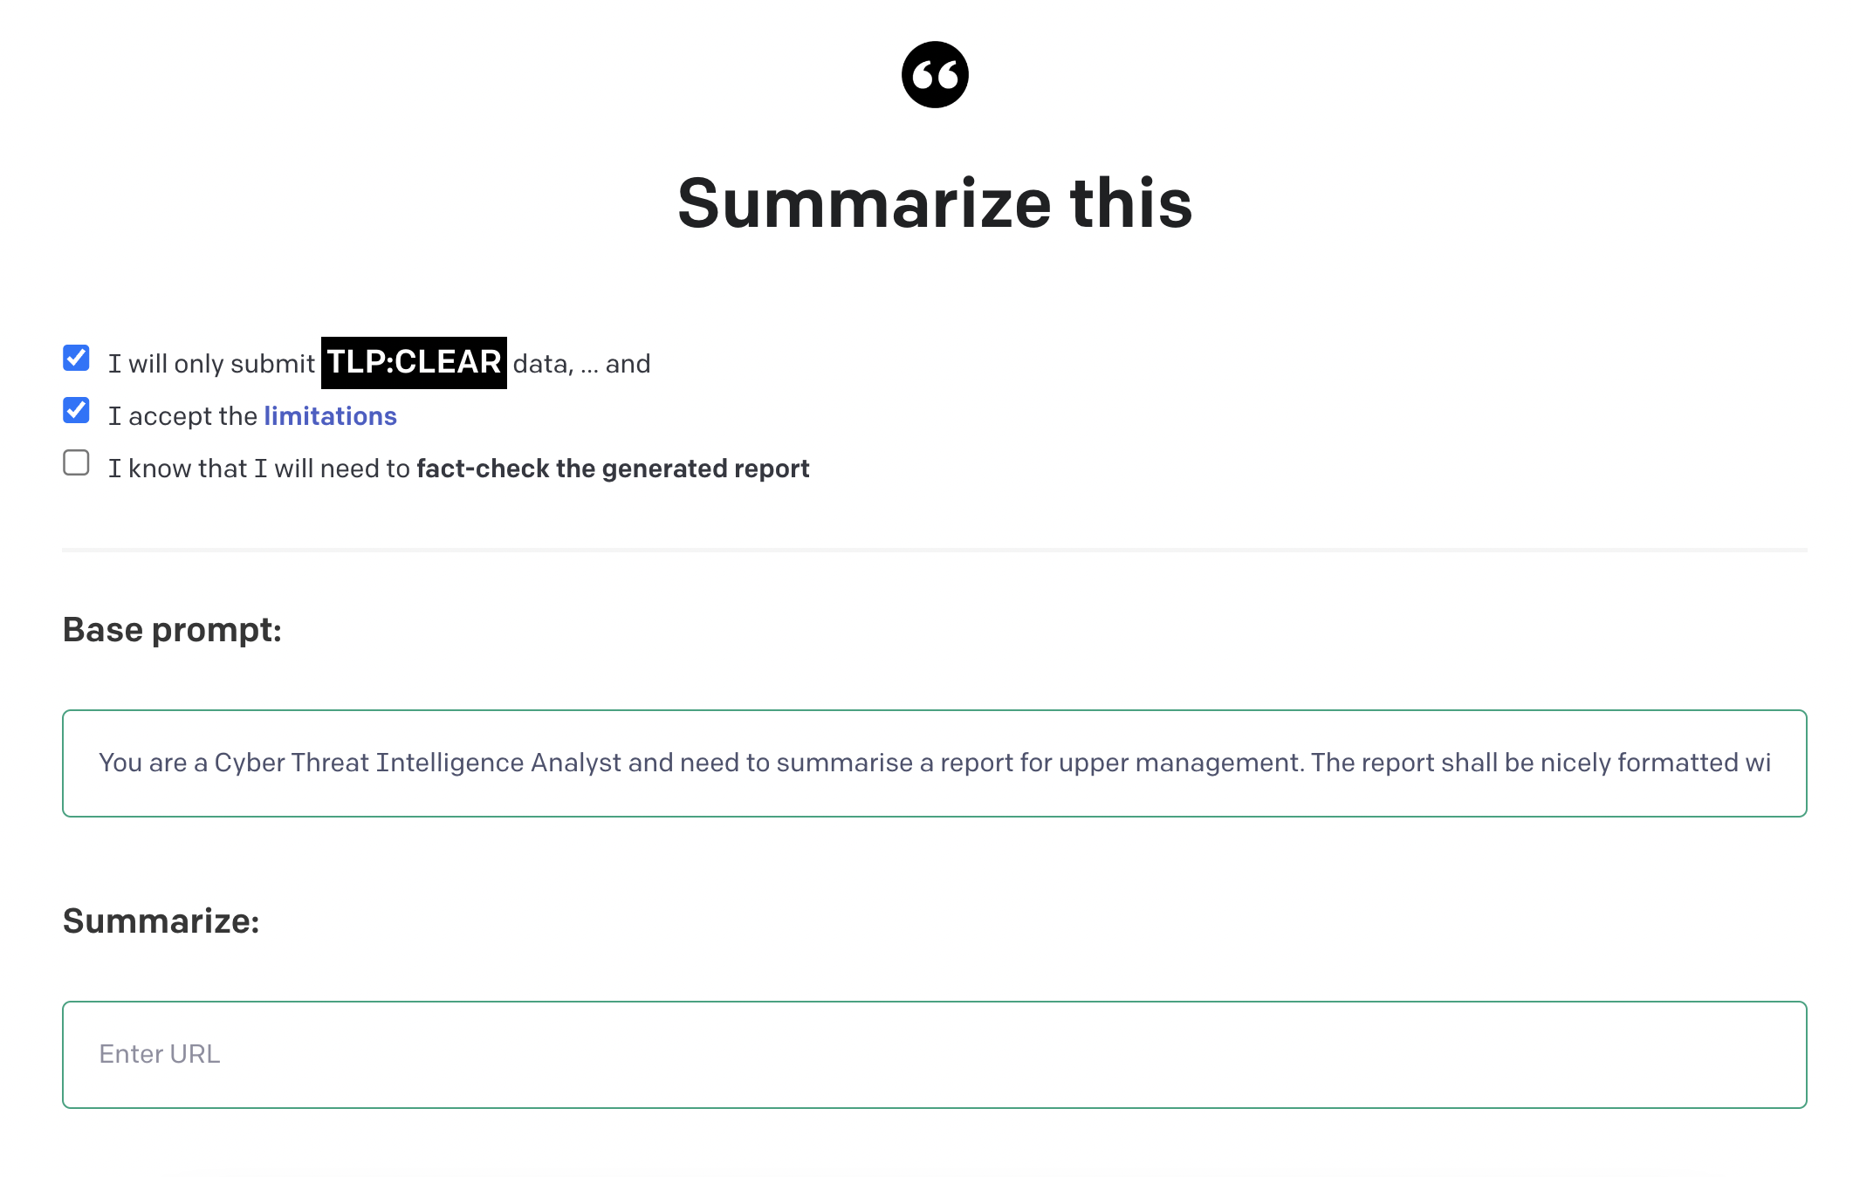
Summarization: a very first naïve approach

Slide 13
Example use-case: summarization
Is there an existing good CTI summarization benchmark? NO!
How is it even possible to compare summaries?
First naïve approach: let humans compare AI summaries vs. human summaries
XXX screenshot & show XLSX sheet, explain:
50 CTI reports
Score -10 (AI == really bad) to +10 (AI is much better than human). 0 == equally good/bad
Average score: 4.7 (!)
85% of cases AI > human
Std-dev high (if the AI is wrong, it’s very easy to spot)

Slide 14
Problem with the naïve approach + solution
Human comparison == ultimate gold standard, but
It does not scale
Enter “Human-like Summarization Evaluation with ChatGPT”, Mingqi Gao, et. al.
https://arxiv.org/abs/2304.02554

Slide 15
Human-like Summarization Evaluation with ChatGPT
Core Idea:
automatic evaluation algos (ROUGE, BERTScore , BARTscore, …)
vs. human evaluation (Likert scale scoring, Pairwise comparison, …)
Can we use gpt-3.5-turbo¹ for simulating a human evaluation?
Turns out, we can
Likert scale score: “given a source document and a generated summary, annotators rate the summary on several dimensions. Typically, this is an absolute evaluation, meaning each summary is evaluated individually without explicit comparison to other summaries. Dimensions usually include factual consistency, informativeness, fluency, etc. The rating scale is usually 1 (worst) to 5 (best).”
[1] gpt-3.5-turbo-0301

Slide 16
Existing automatic evals
ROUGE: comparing via tri-grams/n-grams. Family of standard metrics. “The most commonly used ROUGE measures are ROUGE-1, ROUGE-2, and ROUGE-L, which evaluate the similarity be- tween two texts based on the overlap of unigrams, bigrams, and the longest common sequence. “
BERTScore: “BERTScore (Zhang et al., 2020) assesses the similarity between two texts at the token level by measuring the soft overlap using contextual embeddings from BERT.”
COMET MT benchmark

Slide 17
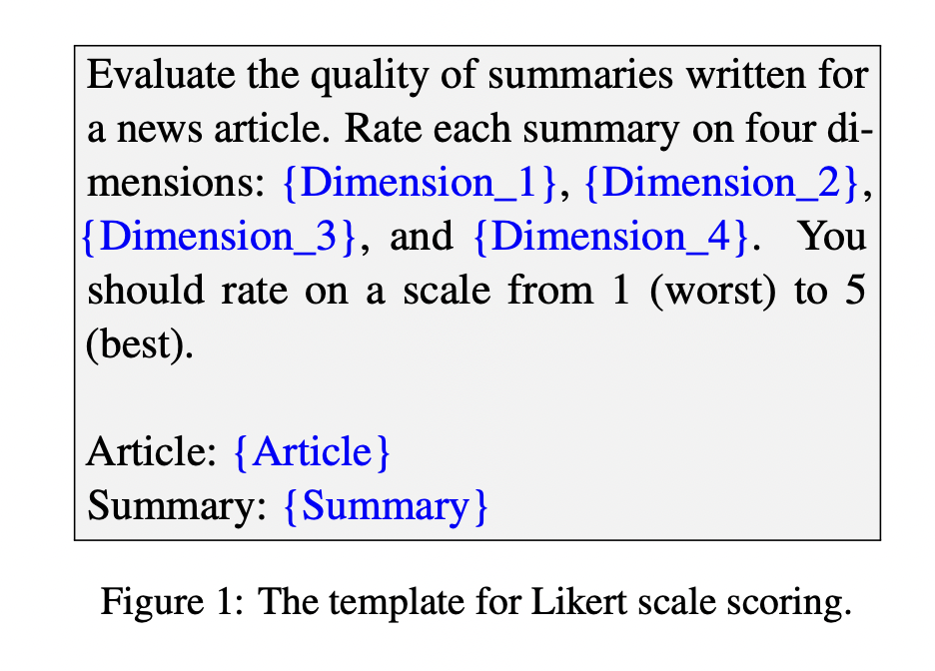
Simulating the Likert Scale score

Slide 18
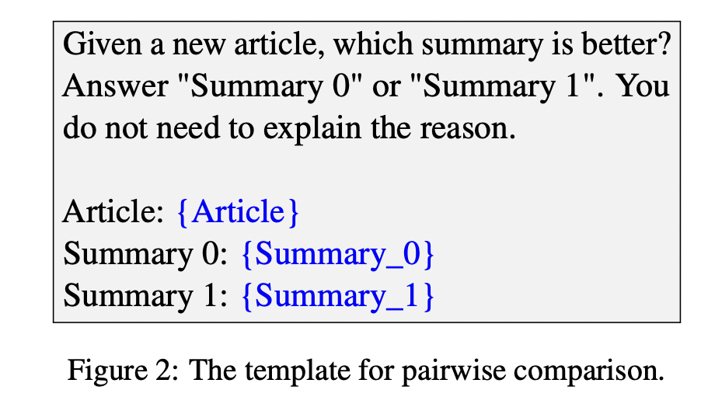
Pairwise comparison simulation

Slide 19
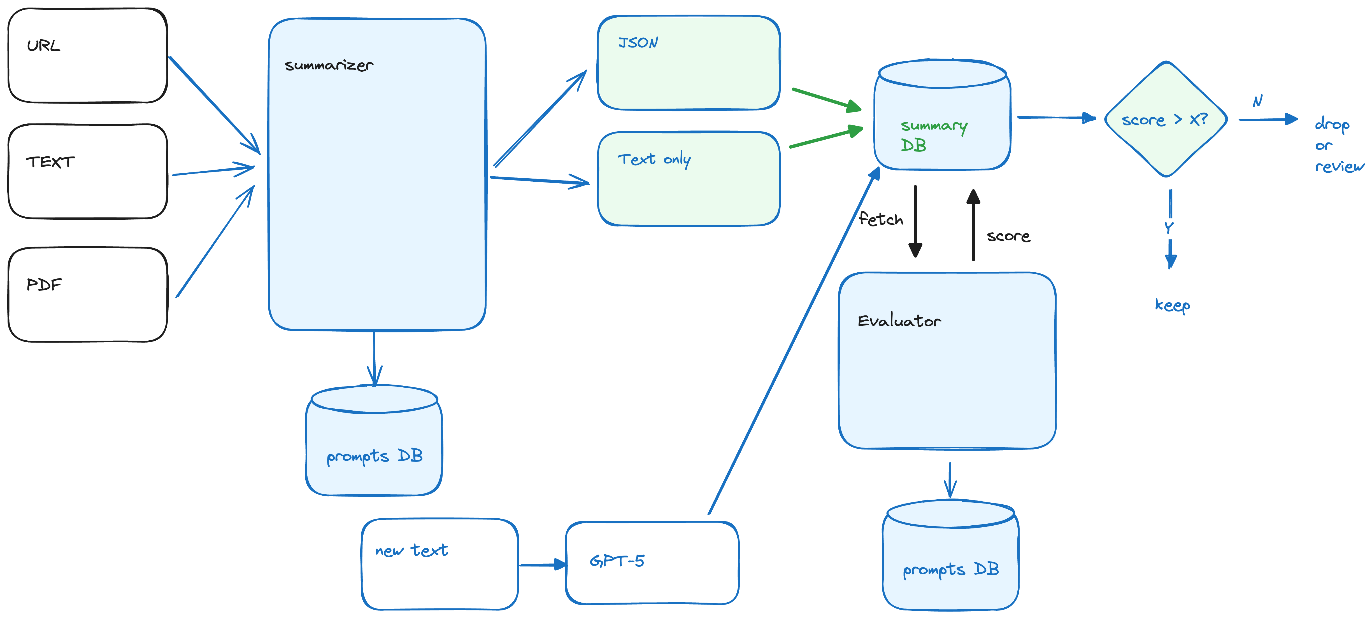
Current architecture

Slide 20
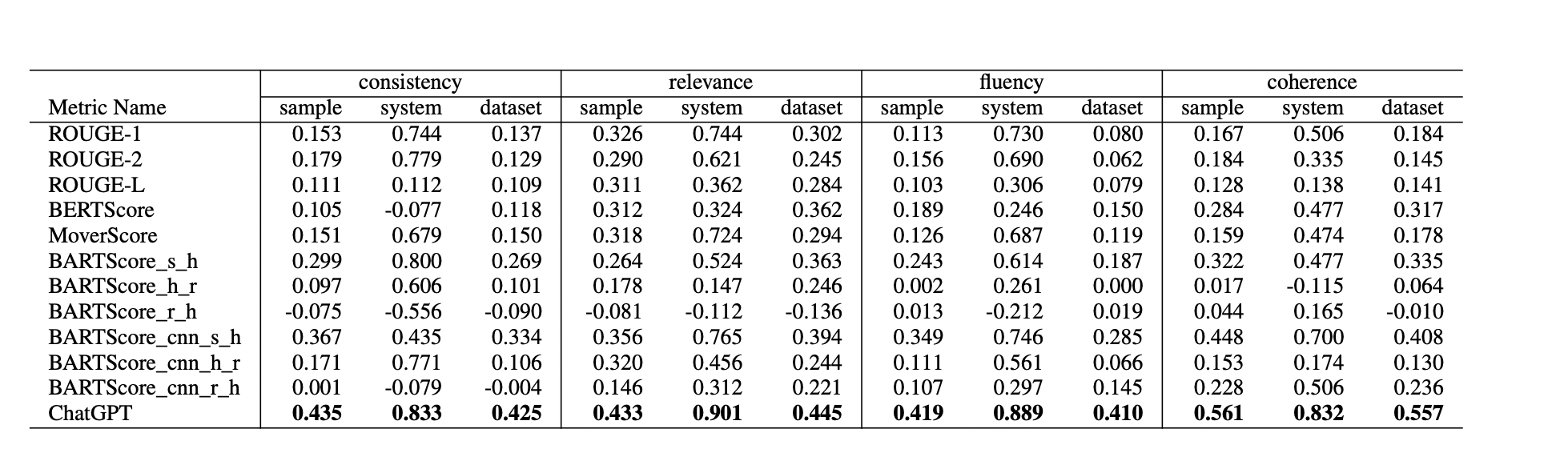
Results¹
[1] Source: https://arxiv.org/abs/2304.02554

Slide 21
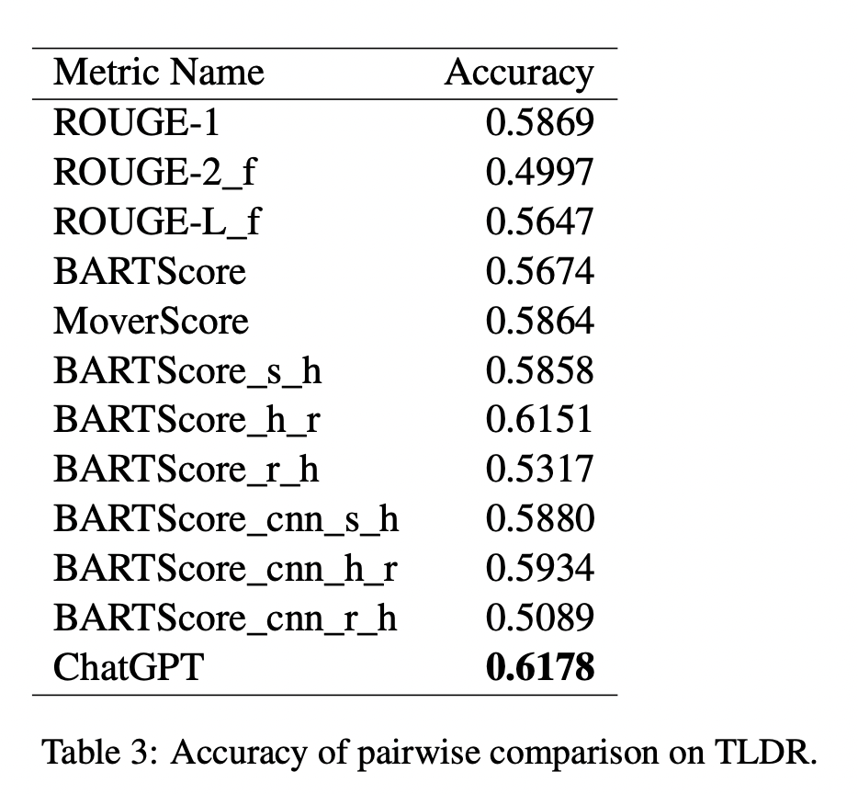
Results (cont)
It works
Why??
Theory: lots of data out there on rating essays etc. (?)

Slide 22
Dataset
… XXX aaron XXX
Description of the data
URL on where to get it

Slide 23
Problems ?
Aren’t we introducing bias, problems etc. bc. we don’t use humans?
Maybe. But it’s a statistical argument of error rates on a meta-level.
Other groups are using GANs to check the quality of a summary
This is WIP.
No one seems to have a perfect solution currently

Slide 24

Conclusion summarization benchmarking
It seems that we can use LLMs for simulating human evaluation of text quality (summarization)
Which allows us to create a large benchmark dataset of CTI text summaries.
With that summary dataset (WIP) we will
Make sample checks
Estimate the error rate of the simulated human eval
Estimate the total error
Can train / fine-tune models
Or evaluate new models w.r.t to summarization of CTI texts

Slide 25
UC 2: RAG
XXX who will take that part ? Who will present? XXX

Slide 26

How to benchmark RAG?
Well understood field
Our current best attempt: → QUIZ approach!
Hand-curated data set with quiz questions . You can then score how well a RAG system can answer the quiz questions
Trick: we can get structured information out of LLMS (JSON mode, kor) → ask questions and ask it to answer in JSON.
→ we can then compare

Slide 27

Guardrails
A big challenge with LLMs is ensuring they’re not hallucinating
Using Knowledge Graph driven RAG and “classical” NLP techniques can help check for that and provide sources for validation

Slide 28
UC 3:NER
XXX who will take that part ? Who will present? XXX

Slide 29
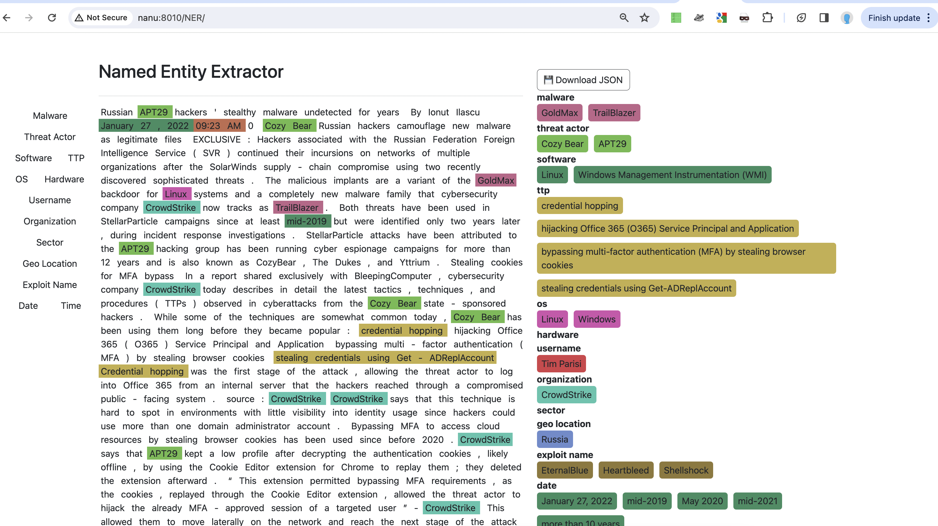
Evaluation NER
Use people ☺ + gamification

Slide 30

We need your support here
Intro & Demo of the NER system
People will get the model upfront, if they sign up XXX where to sign up ? XXX and label 10 reports.

Slide 31
UC 4: Mapping T-codes
XXX who will take that part ? Who will present? XXX

Slide 32
UC 5: knowledge graph (STIX) unification
Syra Marshall (CTO, Elemendar)

Slide 33
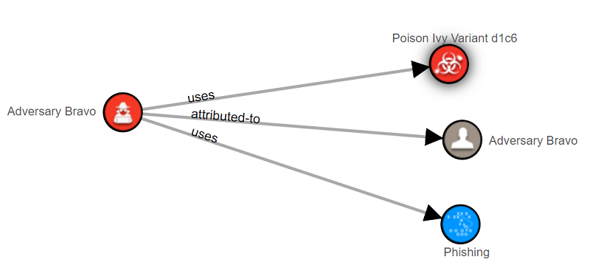

You’ve got a graph, make it better!
STIX graphs for individual documents are great, but…
The power is in combining them to see the whole picture

Slide 34

Challenges
Confidence
Duplication
Naming Conventions and Aliases

Slide 35
Getting the code & data

Slide 36
Public release of the code
https://github.com/aaronkaplan/cti-llm/
XXX better place? Org name? XXX

Slide 37
Key take-aways
LLMs are super interesting, but without benchmarks, it’s like flying without radar and without GPS: you are nearly blind
Creating good benchmarks is hard
No specific CTI benchmark existed
We are attempting to create one, it’s WIP.
We would like to get your help (NER)

Slide 38
Your ideas?
Are you working on something similar? → let’s talk.

Slide 39
Let’s get in touch & thanks!
AI SIG subgroup on a benchmark dataset

